Slide 1
SiS Update Firmware Flow 說明（I2C）
2022/05/13

Slide 2
SiS Commands Table
參考文件:
SiS98xx_I2C_Cmd_Table_V01.xls
使用81, 82, 83, 84, 85, 86等Commands的規格與定義
UpdateFW_BootLoader.tdc ( use the Total Phase Data Center tool )
UpdateFW_nonBootLoader.tdc ( use the Total Phase Data Center tool )

Slide 3
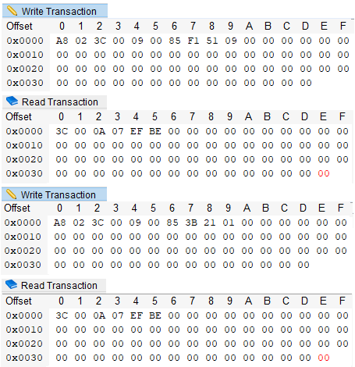
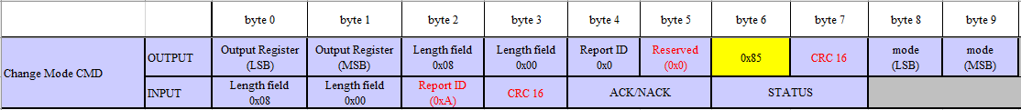
Command 85
設定FW 操作模式。
執行Update FW flow前，設定FW為 Update FW mode
0x85 (byte 6) 0x09 (byte 9) 0x51 (byte 8)
0x85 (byte 6) 0x01 (byte 9) 0x21 (byte 8)
ModeType | byte8 | byte9
DISABLE_DIAGNOSIS_MODE | 0x20 | 0x01
ENABLE_DIAGNOSIS_MODE | 0x21 | 0x01
PWR_CMD_FWCTRL | 0x50 | 0x09
PWR_CMD_ACTIVE | 0x51 | 0x09

Slide 4
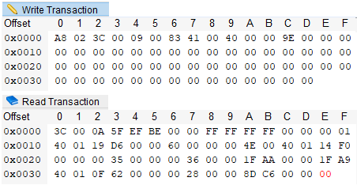
Command 83
指定燒錄ROM 位置&長度。
ROM 位置 需align 4Kbyte，little-endian
例如:0x00 00 40 00 -> 0x00(byte 8) 0x40 (byte 9) 0x00 (byte 10) 0x00 (byte 11)
長度是total 0x84 packet number， little-endian
例如燒入8K的資料
長度 (8*1024)/52=157packet…28byte =>157+1=158(0x9E)
例如燒入4K的資料
長度 (4*1024)/52=78packet…40byte =>78+1=79(0x4F)

Slide 5
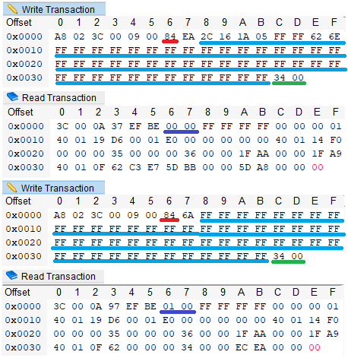
Command 84
傳送FW data
Packet length 建議0x3C(byte 2)
可帶入FW bin data 長度4Bytes ~52Bytes
有效FW bin data長度描述在 Byte 0x3C，Byte 0x3D位置 (little-endian)
Input packet 會回傳已接收幾個0x84 packets Byte 6 ,Byte 7 (little-endian)

Slide 6
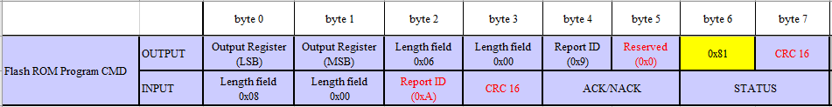
Command 81
燒錄 FW data 到ROM
將多個0x84 packets 傳送的FW bin data 燒錄到ROM

Slide 7
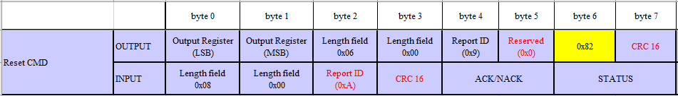
Command 82
FW 重置
FW 燒錄更新完後，需執行FW重置。

Slide 8
Flash ROM map
Flash size :128Kbyte FW Bin size:124Kbyte
注意 Update FW只需要更新 0~124K位置。
Boot-flag若不為\x50\x38\x31\x30，代表燒錄不完整，FW停留在boot-loader, 等待更新流程，此時Main code無法操作.
No. | Start address | Block name | Length
1 | 0x000000 | Boot loader code | 0x04000
2 | 0x004000 | Main code | 0x1B000
3 | 0x01f000 | Remain section | 0x01000
name | Start address | Length(byte) | Data
Boot flag | 0x001E000 | 0x04 | 0x50383130

Slide 9
Update FW Flow
The Update flow not include a boot loader block
The Update flow include a boot loader block
Burn order |  | Address – Length
1 | Clear boot –flag is 0 | 0x01E000 – 0x001000
2 | Burn main code | 0x004000 – 0x01A000
3 | Burn boot –flag | 0x01E000 – 0x001000
Burn order |  | Address – Length
1 | Clear boot –flag is 0 | 0x01E000 – 0x001000
2 | Burn main code | 0x004000 – 0x019000
3 | Burn boot loader code | 0x000000 – 0x004000
4 | Burn boot –flag | 0x01E000 – 0x001000

Slide 10
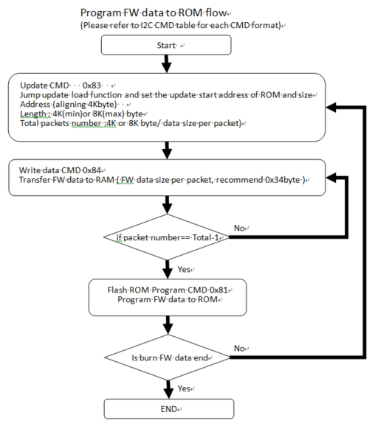
Update Flow Chart
Program FW data to ROM flow

Slide 11
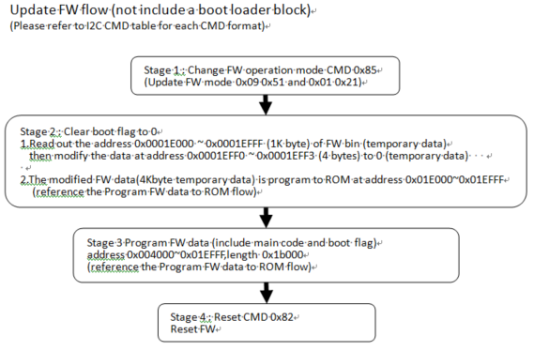
Update Flow Chart (not include a boot loader block)

Slide 12
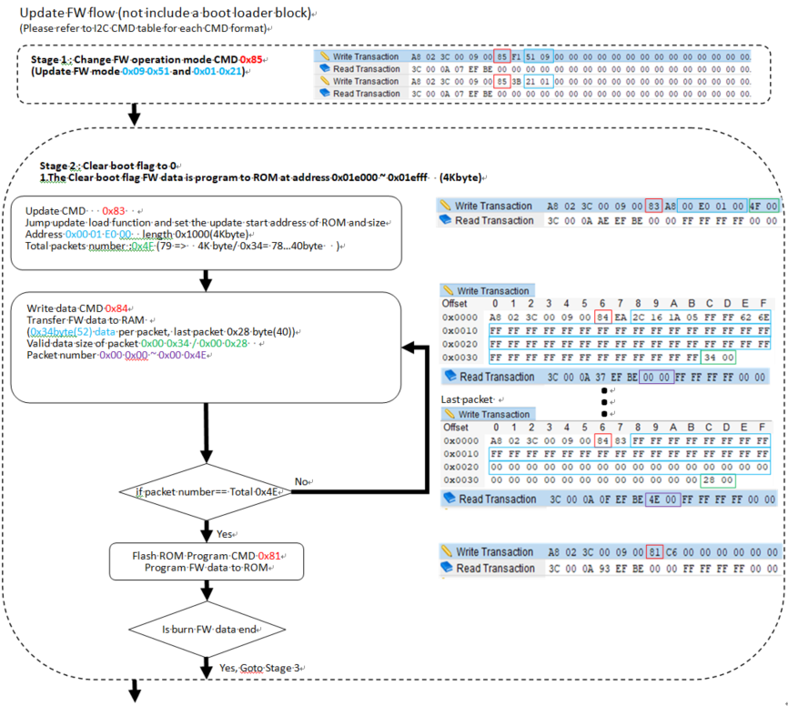
Update Flow Example…1/3
Update FW Flow
(not include a boot loader block)

Slide 13
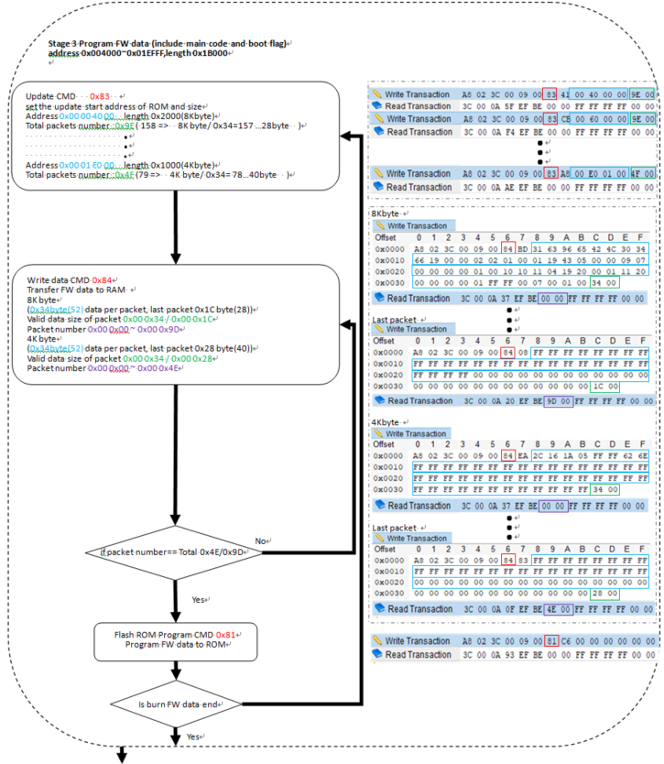
Update Flow Example…2/3

Slide 14

Update Flow Example…3/3

Slide 15
CRC
CRC請參考 CRC.h & CRC.c
Output packet CRC16計算 Byte6 + Byte8~pack length
Input packet CRC16計算 Byte4~pack length
例如 crc16 = crc_check(((unsigned char *)&I2cTxPacket) + 4, m_HostPkgLen, 1);

Slide 16
I2C 時序(I2C INT Pin)
I2C clock :300Khz
I2C Write data 後polling I2C INT Pin為Low時可 Read data
SIS CMD之間需要大於4ms delay time
SIS CMD
(N)
Output Packets
(I2C Write Data)
Input Packets
(I2C Read Data)
Polling I2C INT Pin Low
>4ms
SIS CMD
(N+1)
Output Packets
(I2C Write Data)
Input Packets
(I2C Read Data)
Polling I2C INT Pin Low

Slide 17
I2C 時序(No I2C INT Pin)
I2C clock :300Khz
I2C Write Read data之間需要5ms delay time
SIS CMD之間需要大於4ms delay time
SIS CMD
(N)
Output Packets
(I2C Write Data)
Input Packets
(I2C Read Data)
5ms
>4ms
SIS CMD
(N+1)
Output Packets
(I2C Write Data)
Input Packets
(I2C Read Data)
5ms

Slide 18


Legal Disclaimer
Information in this document is provided for the evaluation of the potential business between Silicon Integrated Systems Corp. and you or other purposes agreed by Silicon Integrated Systems Corp. No license, express or implied, by estoppel or otherwise, to any rights or interests, including but not limited to intellectual property rights, is granted by this document.
SiS, , , HyperStreaming, Mirage, MuTIOL, 妙渠, Xabre, HyperZip,
SiS HyperZip Connect, PepLink, Glamo, CubicLook and MotionFixing are trademarks or registered trademarks of Silicon Integrated Systems Corp.
Other names and brands may be claimed as the property of others.
Copyright © (year), Silicon Integrated Systems Corp. All rights reserved.

Slide 19


